Slide 1

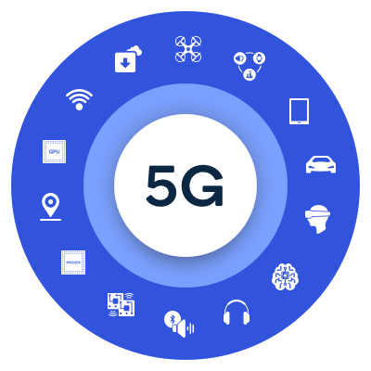

Mobile Computing
WS 2023-24
Implementation and Testing of a 5G Core Network for Slicing and Application Connectivity using UERANSIM
Guided by : Armin Lehmann
Masters in Engineering
Information Technology
Team Gen5 Designers - Project members
Nastayeen Abdul Majid 1427970
Shiva Kumar Biru 1436929
Jenny Nadar 1427226
Sriram Karunanithi 1438891
Start date : 4 Dec 2023
End date : 25 Feb 2024
1

Slide 2
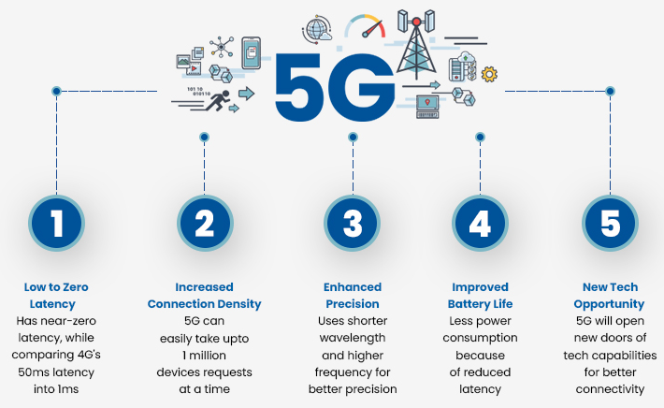
Contents
Introduction to our project
Project architecture
Requirements
Planning
Realization of the project
Execution
Network slicing
Conclusion
References
2

Slide 3

1. Introduction to our project
Objective
5G core, including
Radio Access Networks (RANs)
User Equipment (UEs)
Data Networks (DNs)
Network Slicing
One or multiple services with specific functionality to different tenants
Ensure the separation of the services and end-users (Network slicing)
Set of RANs and DNs connected via slices
Implement 5G core with Service-based Architecture (SBA) several network functions.
3

Slide 4

..Introduction to our project
Scope of the Project
Fundamental 5G design principle is a Service Based Architecture (SBA)
comprehensive modularization for compiling & combining network functions flexibly.
Design principle of network softwarization, like
application of NFV (Network Functions Virtualisation), SDN (Software-defined Networking) for the realization of Network Function instances and their interaction, & multi-tenant capability (network slicing)
Enabling several tenants, like
a mobile network operator, a fixed network operator & MVNO (Mobile Virtual Network Operator) for eMBB, a Smart Grid Provider & service provider for autonomous vehicles for URLLC,
& for operating several logical communication networks with different characteristics parallelly on one physical network platform
4

Slide 5
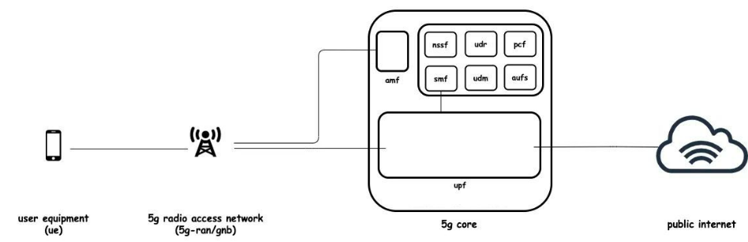
General Architecture of 5G
User Plane
User Equipment UE
RAN/gNodeB (gNB)
Control Plane
AMF
NSSF
NRF
SMF
UDM
PCF
AUSF
UPF
SCP
Data Network
Interfaces
Network slicing
5

Slide 6
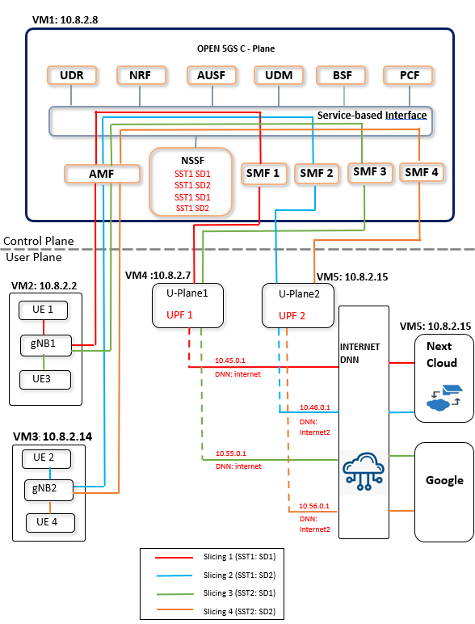
2. Project architecture
Components
5 Virtual Machines(VMs)
User Plane
4 User Equipments(UEs)
2 gNodeB(gNBs)
Control Plane
2 User Plane Function (UPFs)
4 Session management function(SMFs)
NSSF
SST1 SD1, SST 1 SD2
SST2 SD1, SST2 SD2
Data Network
NextCloud
6

Slide 7
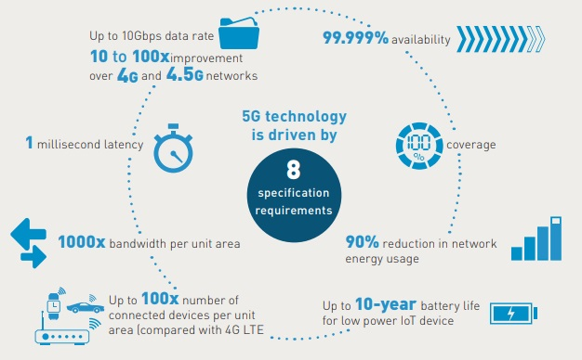
3. Requirements
Installation of virtual box
Creation of Virtual machines for both 5Gcore and UERANSIM
Install Operating Systems
Go to Network settings in virtual box to enable Adapters 1 and 2
Changes for creating a static IP for each VM
Installation of Wireshark
Installing MongoDB and Open5GS
Getting MongoDB
Installation of Open5GS in our Ubuntu on VM
Installation of WebUI of Open5GS
Installation of UERANSIM
Installation of Next Cloud
7

Slide 8
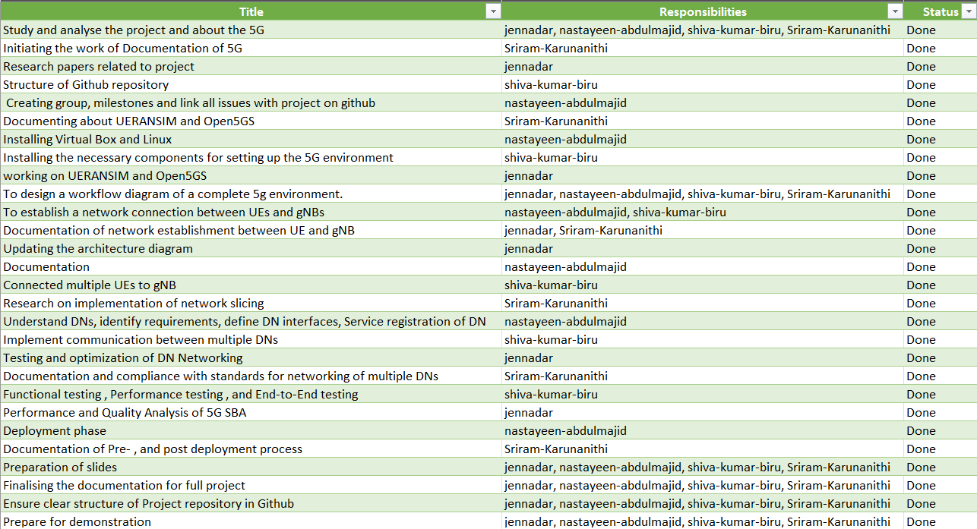
4. Planning
8

Slide 9
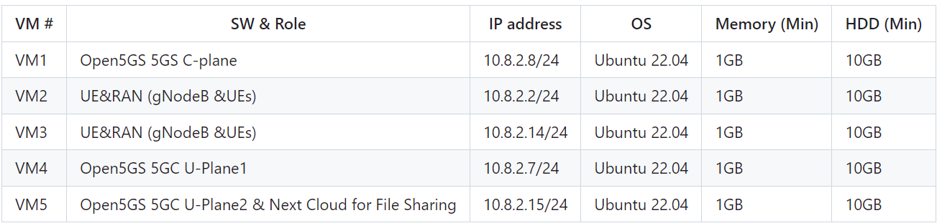
5. Realization of the project
Each VM are as follows:
Four UEs were created in two separate VMs.
Separate slicing to each User Equipment for File Sharing.
UE1 uses the slice marked with colour Red and similarly UE2 uses slice marked with colour Blue
UE3,UE4 is used to connect to the website.
9

Slide 10
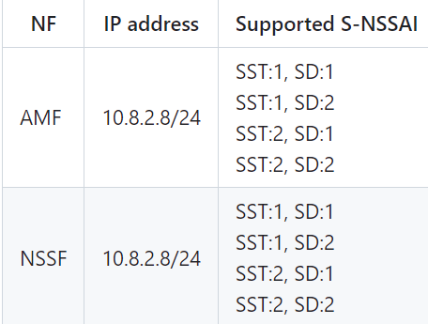
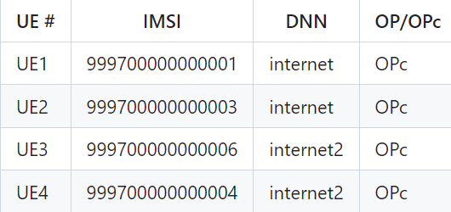
Subscriber Information (other information is the same) is as follows. These User informations were registered with Open5GS WebUI
UE1 and UE2 have access to File sharing with UPF1 and UPF2 respectively. The NSSF file is used for network slice selection as per the slicing parameters provided by the UEs.
10

Slide 11
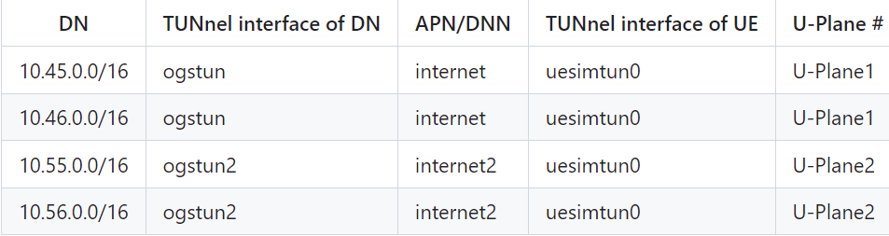
Each DN are as follows.
11

Slide 12
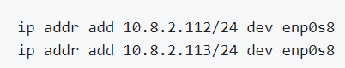
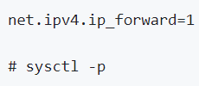
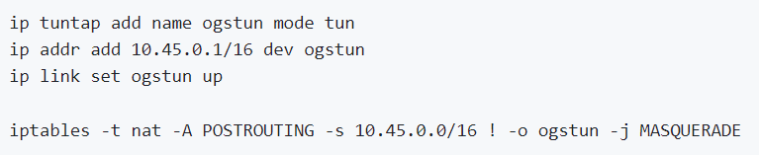
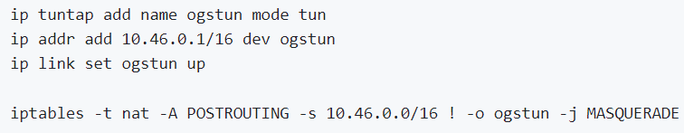
6. Execution
A) Prerequisites
Network Settings of Open5GS 5GC C-Plane
Before starting the SMF's files, configure the network setting of SMF1&2
Network Settings of Open5GS 5GC C-Plane UPF-1&2
configure the TUNnel interface and NAPT.
12

Slide 13
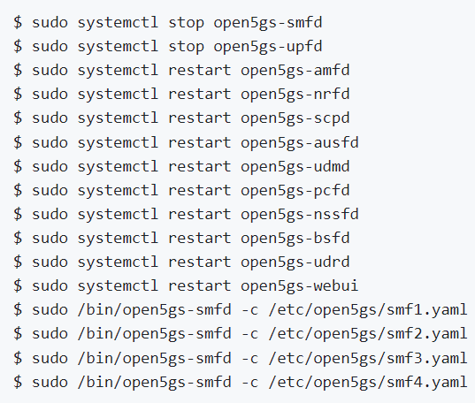
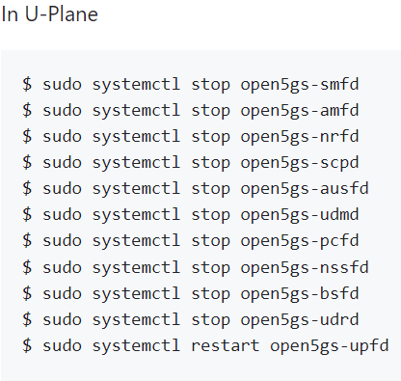
B) SMF to UPF connection Establishment
After configurations of the components of 5GC in Open5GS, restart the 5GC services. As multiple SMFs need to be implemented, these services are made to run separately.
13

Slide 14
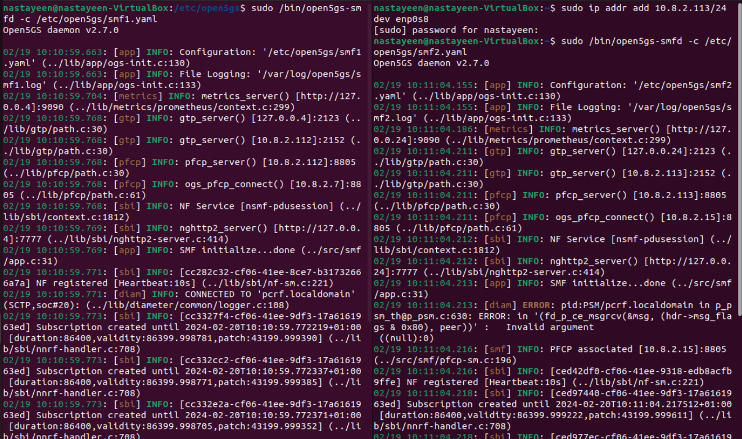
…Execution
B.1) SMF1 to UPF1 connection Establishment
Establishing a PFCP connection
14

Slide 15
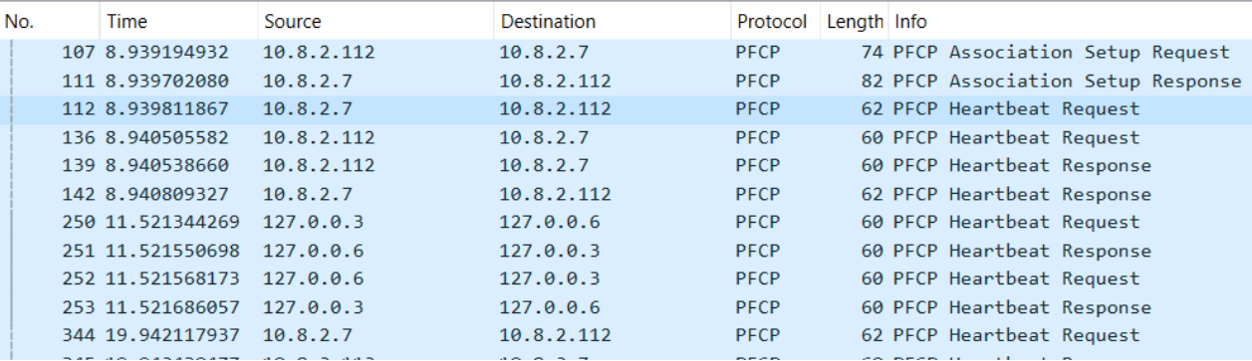
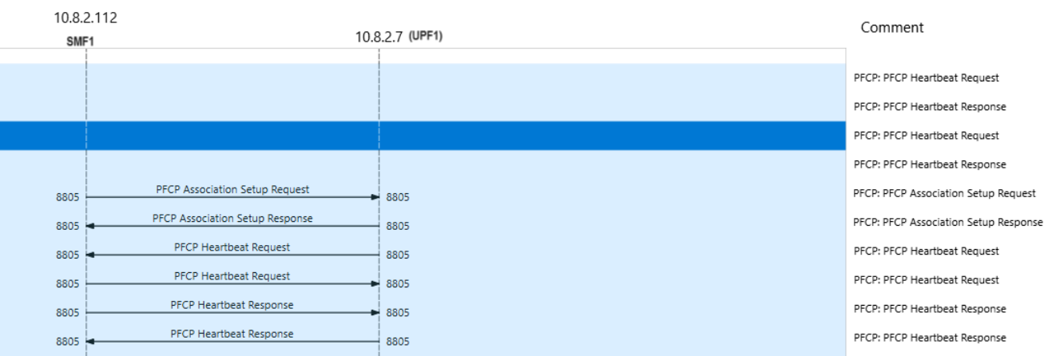
wireshark traces of PFCP association between SMF1 and UPF1
The MSC of PFCP association b/w SMF1 and UPF1
15

Slide 16
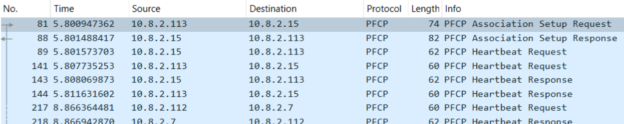
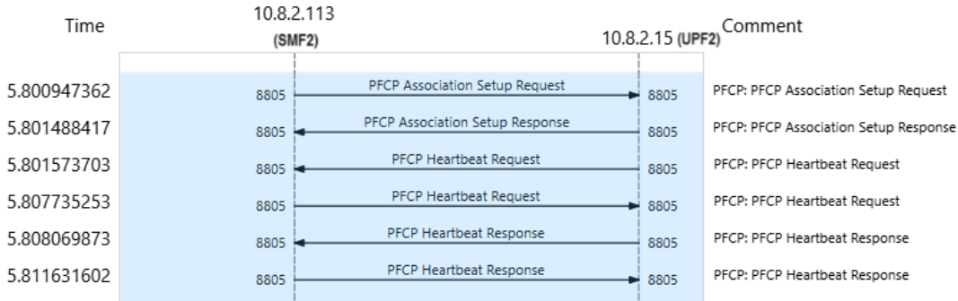
B.2) SMF2 to UPF2 connection Establishment.
Wireshark traces of PFCP association between SMF2 and UPF2
The MSC of PFCP association between SMF2 and UPF2
16

Slide 17
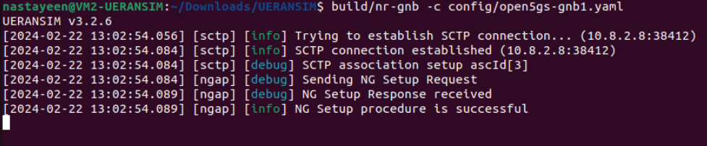
C) Running UERANSIM
C.1) NG Setup between gNB 1 to AMF
Once the 5GC is up and running, initialization of the gNB1 & UE1 can be performed by the following commands in the UERANSIM/build directory respectively.
To run gNB -
To ensure successful connection between 5GC and gnb, we need to receive “NG connection successful” in the same terminal.
17

Slide 18
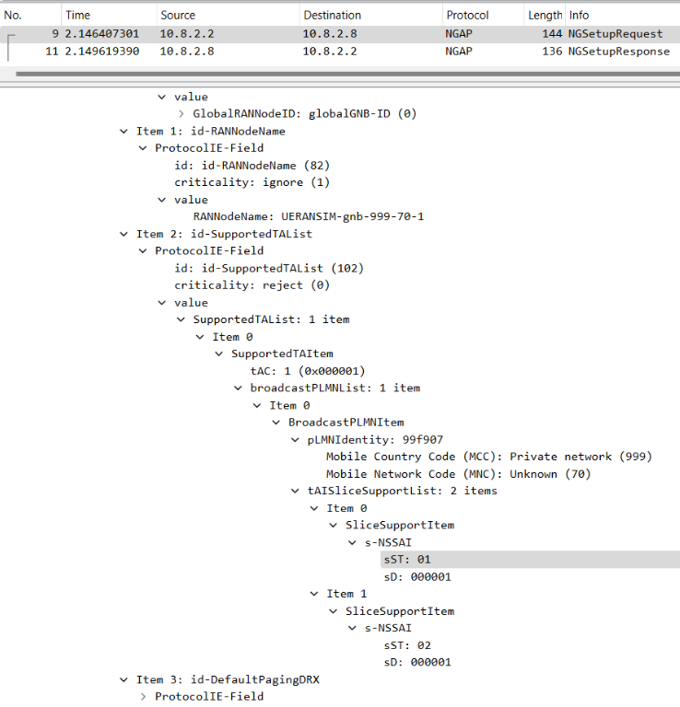
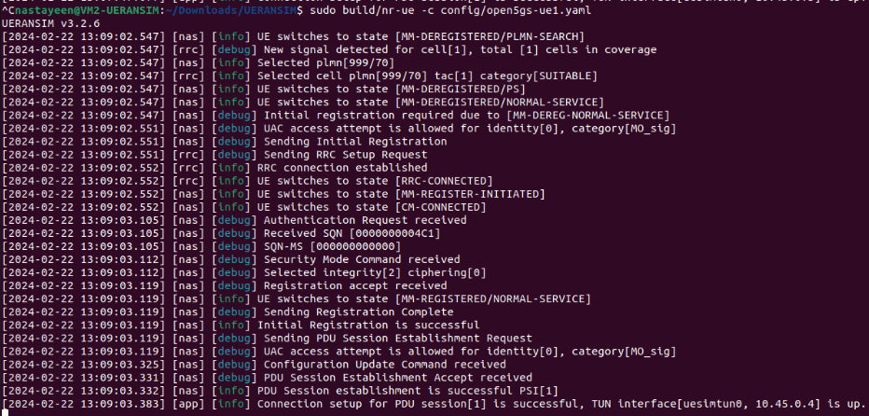
To run the first ue, UE1 -
Successful initialization of UE can be verified by receiving “PDU session establishment successful” with TUNnel interface[uesimtun0,10.45.0.4] in the same terminal
This figure represents the Wireshark traces which is generated after the successful start of UERANSIM gNB, between gnb and AMF
18

Slide 19
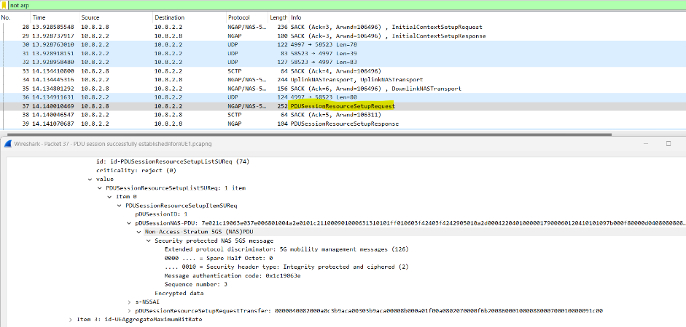
The NGAP traces has the NG set up a request and response to initialize a gNB and PDU association request and response for initializing the UE1
19

Slide 20
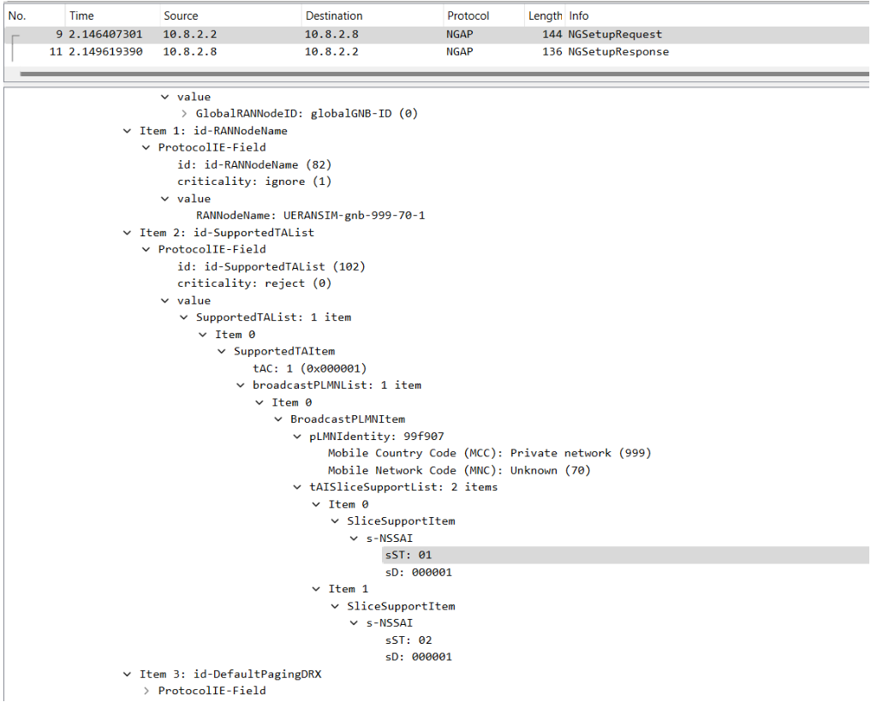
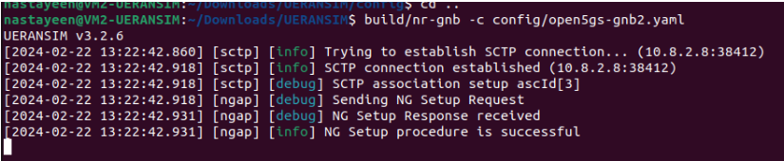
D.2) NG Setup between gNB2 to AMF
Successful connection between 5GC and gnb
Wireshark traces which is generated after the successful start of UERANSIM gNB, between gnb and AMF
20

Slide 21
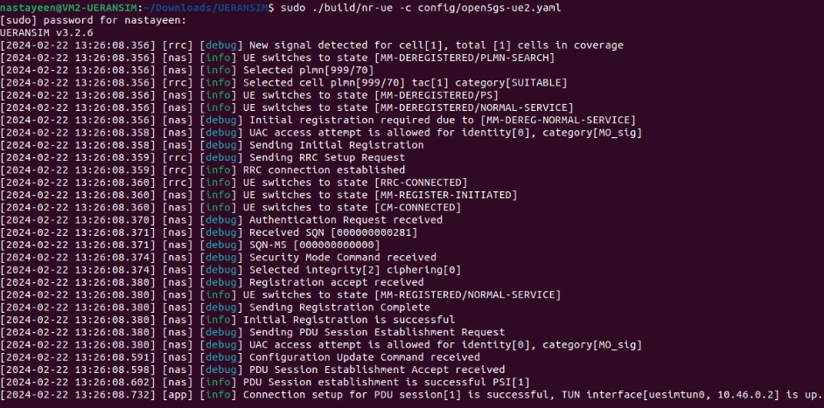
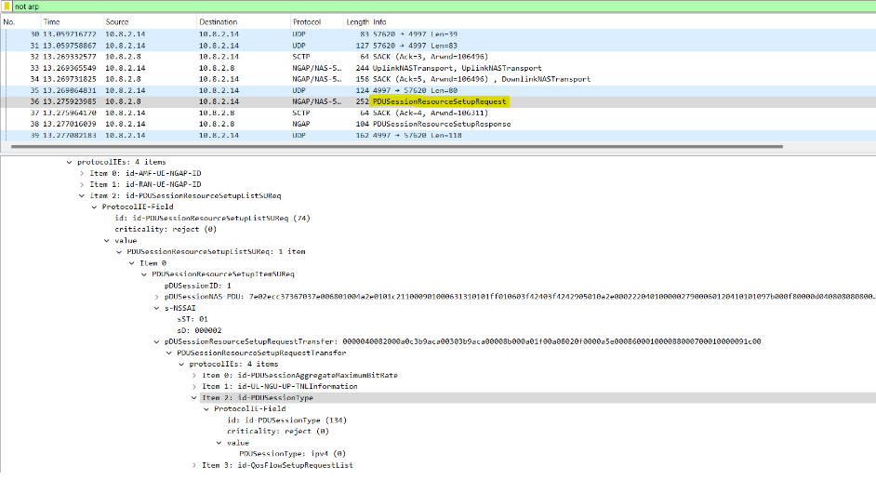
Successful initialization of UE can be verified by receiving “PDU session establishment successful” with TUNnel interface[uesimtun0,10.46.0.2] in the same terminal
The NGAP traces has the NG set up a request and response to initialize a gNB and PDU association request and response for initializing the UE1
21

Slide 22
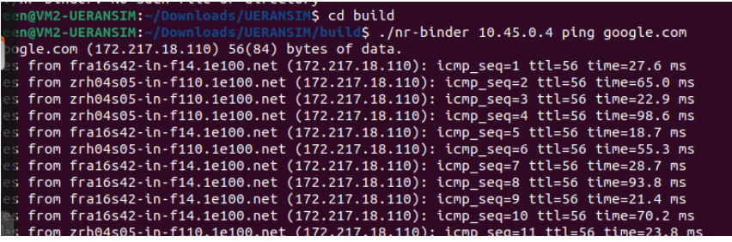
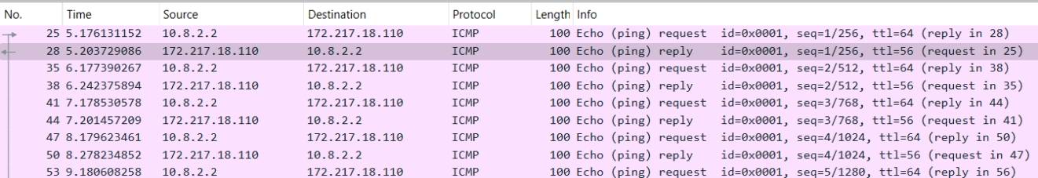
D.3) Testing & accessing Data Networks
D.3.1.Testing the network using UE1
To ping google.com Open a new terminal ./nr-binder 10.45.0.4 ping google.com
Wireshark traces
22

Slide 23
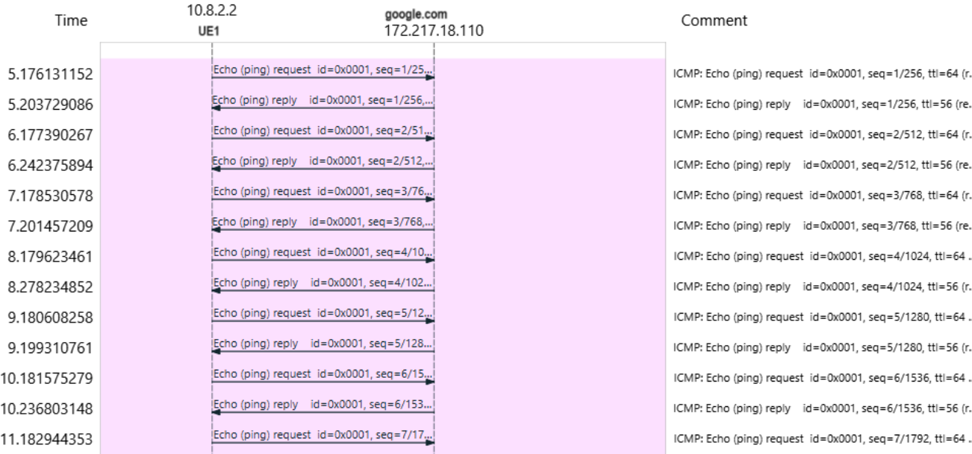
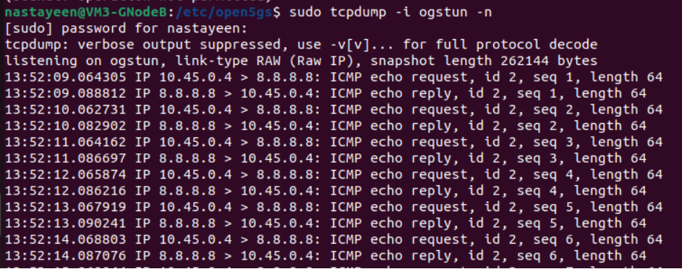
MSC diagram
Confirm by using tcpdump that the packet goes through if=ogstun on U-Plane1
23

Slide 24
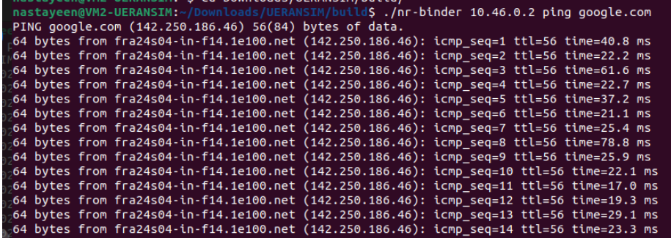
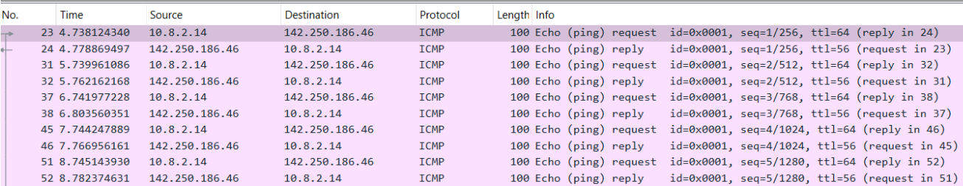
D.3.2) Testing the network using UE2
To ping google.com Open a new terminal
Wireshark traces
24

Slide 25
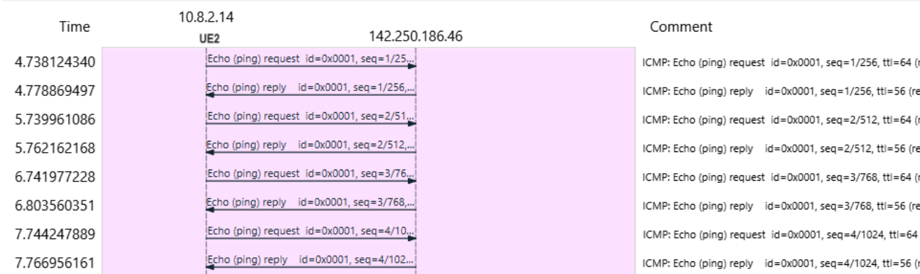
MSC diagram for Testing the network using UE2
25

Slide 26
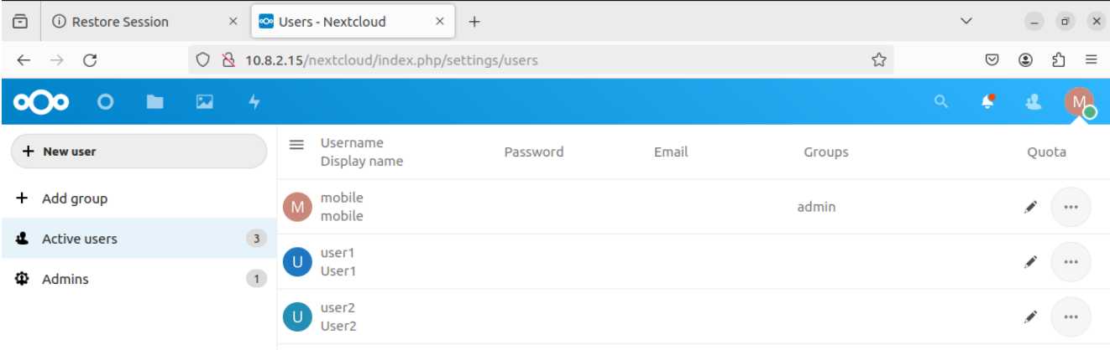
7. Network slicing
7.1) Next Cloud
Nextcloud is a self-hosted, open-source file sharing and collaboration platform that allows users to store, access, and share their data from any device or location.
UE1 send file to UE2
7.1.1) Creation on Users in Next Cloud (Server)
26

Slide 27
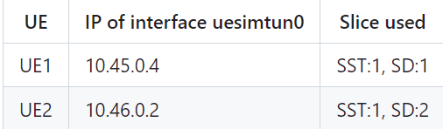
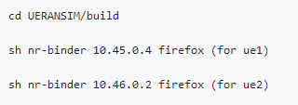
Steps to access file sharing service
NG Connection establishment between gNB and 5GC-Control Plane.
PDU session establishment between U-Plane 1 and UE1.
PDU session establishment between U-Plane 2 and UE2.
The IP address for the ‘uesimtun0’ interfaces of both the UEs:
Once the UEs are assigned the IP addresses on ‘uesimtun0’ interface, ‘nr-binder’ tool is available as a part of UERANSIM to access the NextCloud server via web browser already installed in both UE1 and UE2
27

Slide 28
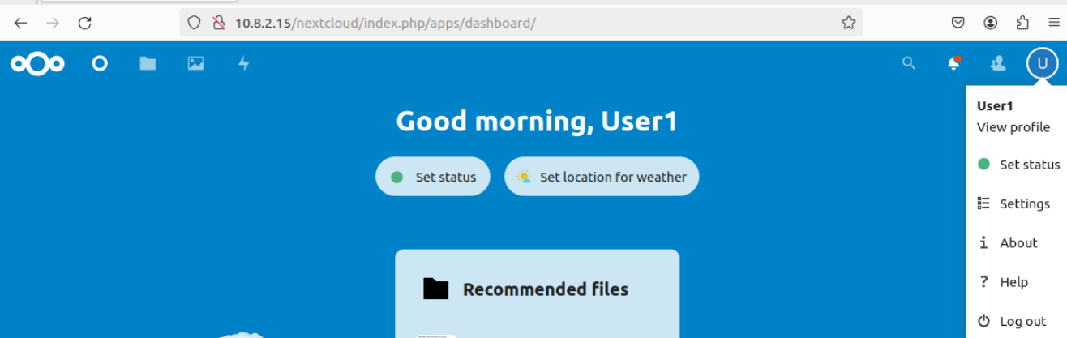
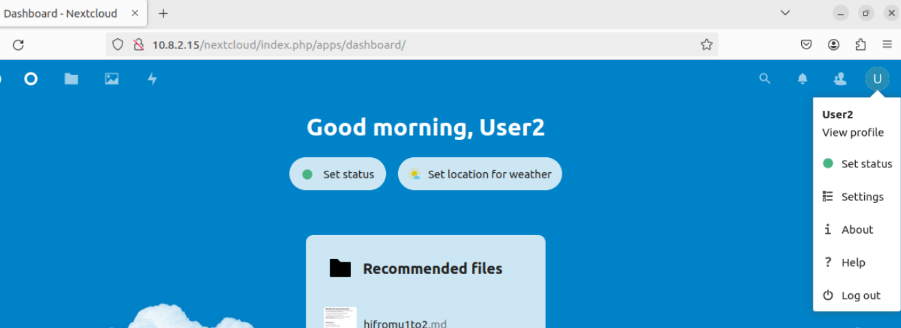
6. In the browser windows the NextCloud server can be accessed from the url https://10.8.2.15/nextcloud/ by logging in to users ‘UE1’ and ‘UE2’ already registered in the NextCloud server (10.8.2.15) ‘ue1’ and ‘ue2’ respectively.
28

Slide 29
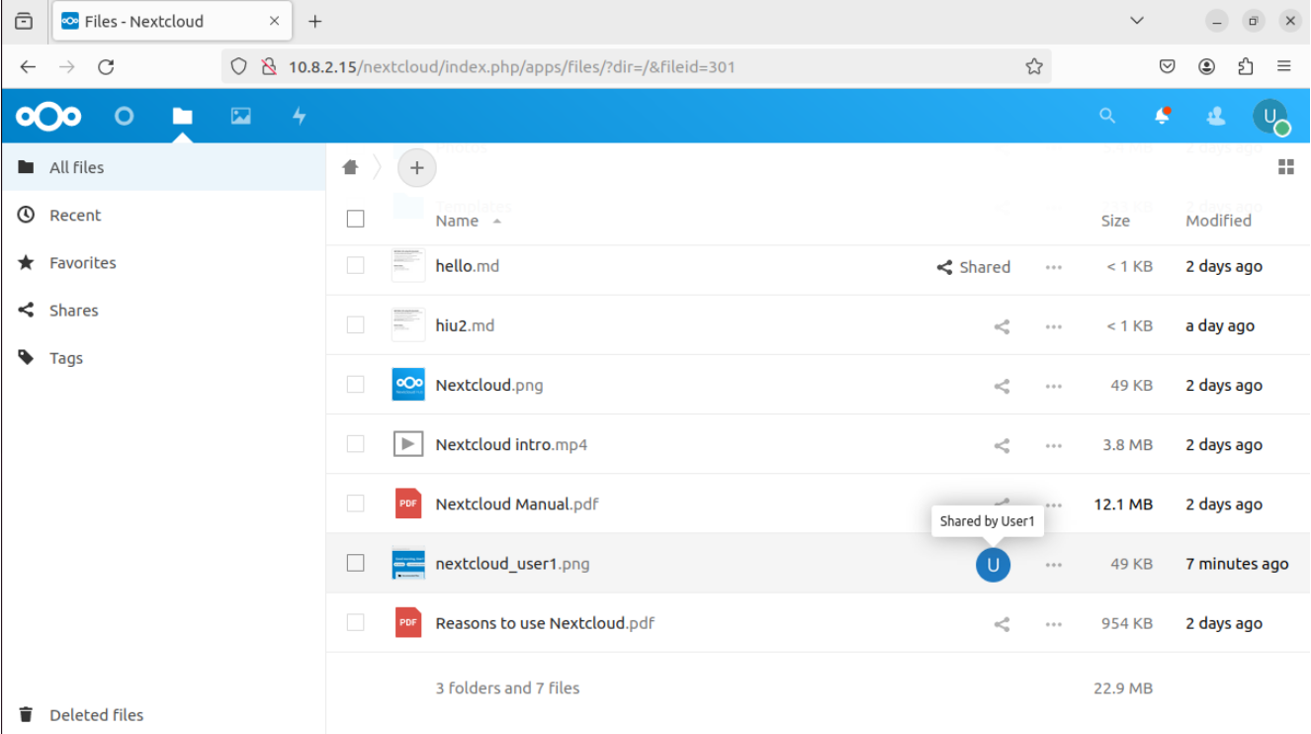
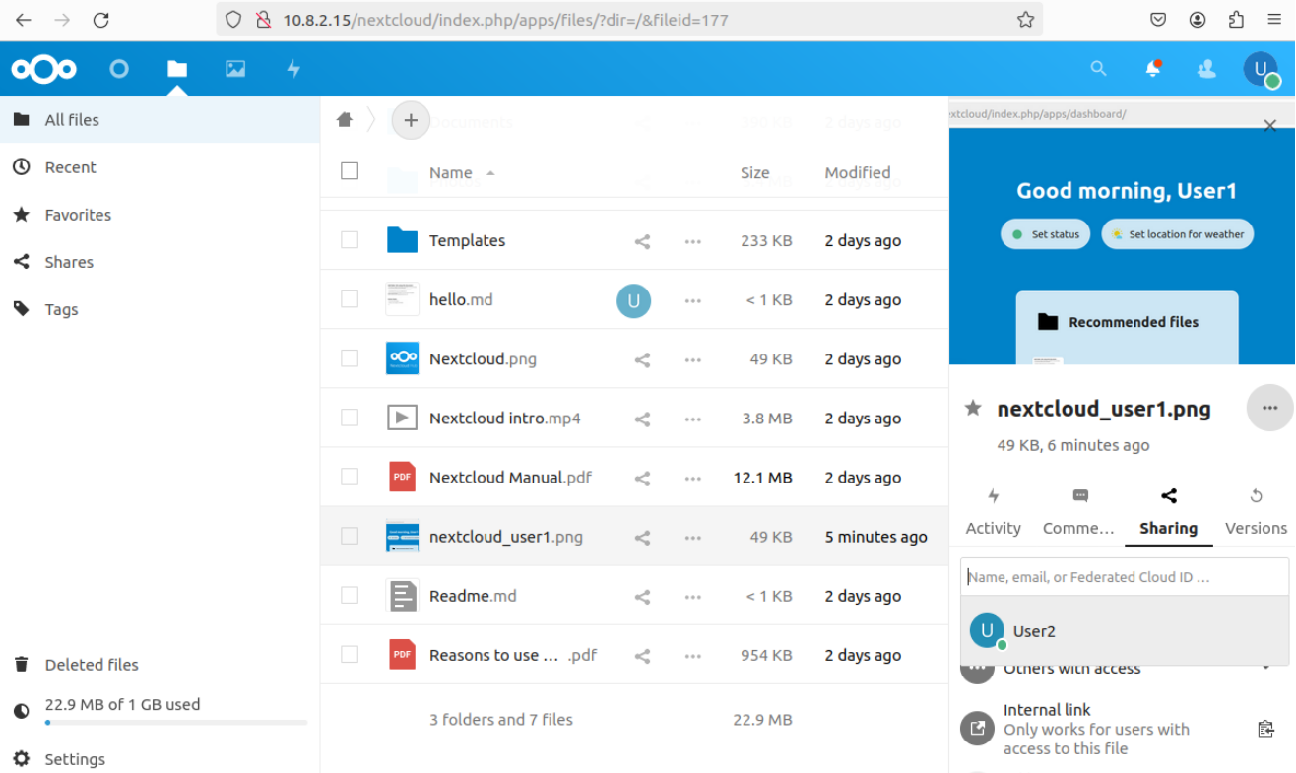
7.1.2) File Sharing from UE1(SST:1, SD:1) to UE2 (SST:1, SD:2)
29

Slide 30
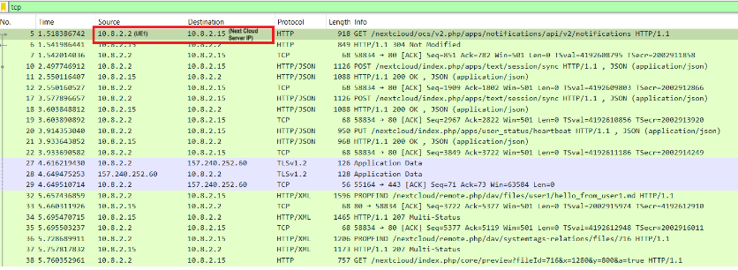
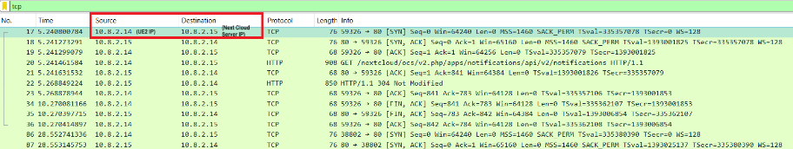
The wireshark traces are captured at UE1.
Similarly the wireshark traces are captured at UE2. This traces show that the UE2 is connected to Next cloud Server.
30

Slide 31
8. Conclusion
Implementation and testing of the 5G core network utilizing UERANSIM have demonstrated the feasibility and efficacy of slicing in catering to diverse user requirements.
By assigning different slices to individual UE devices, the network effectively allocated resources and prioritized traffic for file transfer and website access.
The project highlights the potential of slicing in enhancing network efficiency, scalability, and flexibility in 5G deployments.
Moving forward, further optimization and refinement of slicing strategies can contribute to the seamless integration of diverse services and applications in future 5G networks.
31

Slide 32
9. References
Trick, U., 2021. 5G - An Introduction to the 5th Generation Mobile Networks. De Gruyter STEM Hrsg. Berlin/München/Boston: De Gruyter Oldenbourg.
Open-source documentation (no date). Open5GS [Online]. Available at: https://open5gs.org
Open-source documentation (no date). Nextcloud - Online Collaboration platform [Online]. Available at: https://nextcloud.com
Li, X., Samaka, M., Chan, H. A., Bhamare, D., Gupta, L., Guo, C., & Jain, R. (2017). Network Slicing for 5G: Challenges and Opportunities. IEEE Internet Computing, 21(5), 20–27. doi:10.1109/mic.2017.3481355
3GPP, "TS 23.501: System Architecture for the 5G System," Release 15.
Smith, J., Brown, A., & Chen, L. (2020). Simulation of 5G-RAN UERANSIM for Performance Evaluation. IEEE Transactions on Wireless Communications, 19(3), 1876-1888. doi: 10.1109/TWC.2019.2951128.
Wang, Y., Li, L., Mao, S., & Li, G. (2021). Design and Analysis of Control Plane for Multiple SMF/NSSF in 5G Networks. Wireless Personal Communications, 118(1), 487-501. doi: 10.1007/s11277-020-08015-5.
Khalid, M. W., Kwon, S., Yoon, H., & Pasha, M. A. (2021). Performance Evaluation of Open5GS and UE4ASIM in 5G Networks. IEEE Access, 9, 116785-116798.
Al-Dulaimi, A., Shao, X., Zhang, Y., & Al-Dulaimi, A. (2021). 5G Core Networks: A Comprehensive Survey. IEEE Communications Surveys & Tutorials, 23(1), 705-752.
Ali, S., Bilal, M., Nasser, N., & Aleisa, E. (2021). Performance Analysis of Open5GS User Plane and Control Plane Implementations. IEEE Access, 9, 44731-44741.
Li, B., Liu, Y., Yang, F., & Sun, Y. (2020). Design and Implementation of Access and Mobility Management Function in 5G Core Network. IEEE Access, 8, 131966-131975.
32

